Slide 1
بسم الله الرحمن الرحیم

Slide 2
GCC & Make
Compiling, Linking and Building C/C++ Applications
سید سروش حسین‌علی‌پور

Slide 3
تاریخچه
GCC
Richard Stallman
GNU C Compiler
GNU Compiler Collection
The founder of the GNU Project
GNU Toolchain
Support Many languages
gcc
GNU Make
GNU Binutils
GNU Debugger GDB
GNU Autotools: A Build system (Autoconf, Autoheader, Automake, Libtool)
GNU Bison
C gcc
C++ g++
Fortran gfortran
Go gccgo

Slide 4
نسخه زبان
C++ Standard Support
GCC Versions
C++98 –std=c++98 or -std=gnu++98
C++11 –std=c++11 or –std=gnu++11
C++14 –std=c++14 or –std=gnu++14
C++17 –std=c++17 or –std=gnu++17
C++20 –std=c++2a or –std=gnu++2a
GCC version 1 1987
GCC version 2 1992: supports C++
GCC 10.2
GCC 9.3
Development GCC 10.0

Slide 5
Install
sudo apt install g++
g++ --version
g++ (Ubuntu 9.3.0-10ubuntu2) 9.3.0 Copyright (C) 2019 Free Software Foundation, Inc. This is free software; see the source for copying conditions. There is NO warranty; not even for MERCHANTABILITY or FITNESS FOR A PARTICULAR PURPOSE.

Slide 6
Man page
man g++ | col –b > gcc.txt
whereis g++

Slide 7
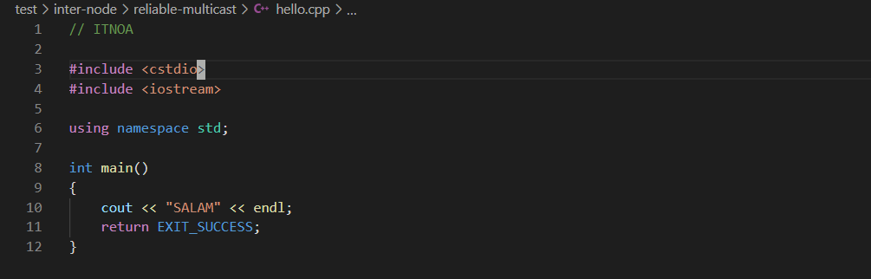
شروع کنیم
g++ hello.cpp
chmod a+x a.out
./a.out
g++ -o <output name> hello.cpp

Slide 8
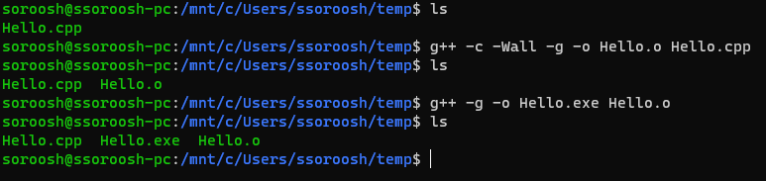
کمی جلوتر
Compile and Link Separately
More GCC Compiler Options
Compile and Link Separately
-o: Specifies the output
-Wall: prints all warning
-g: generates additional symbolic
Notes:
Debugging information for use with gdb debugger
By default same name with –c for compiling
Multiple files
-shared

Slide 9
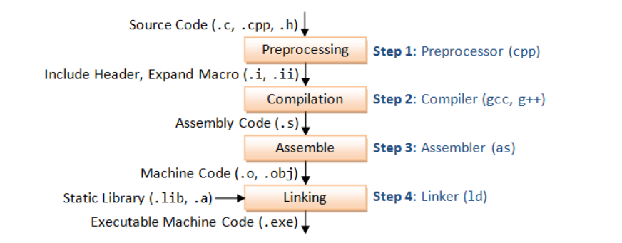

Slide 10
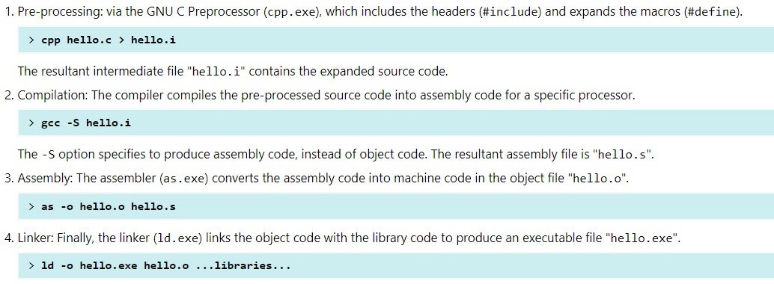

Slide 11
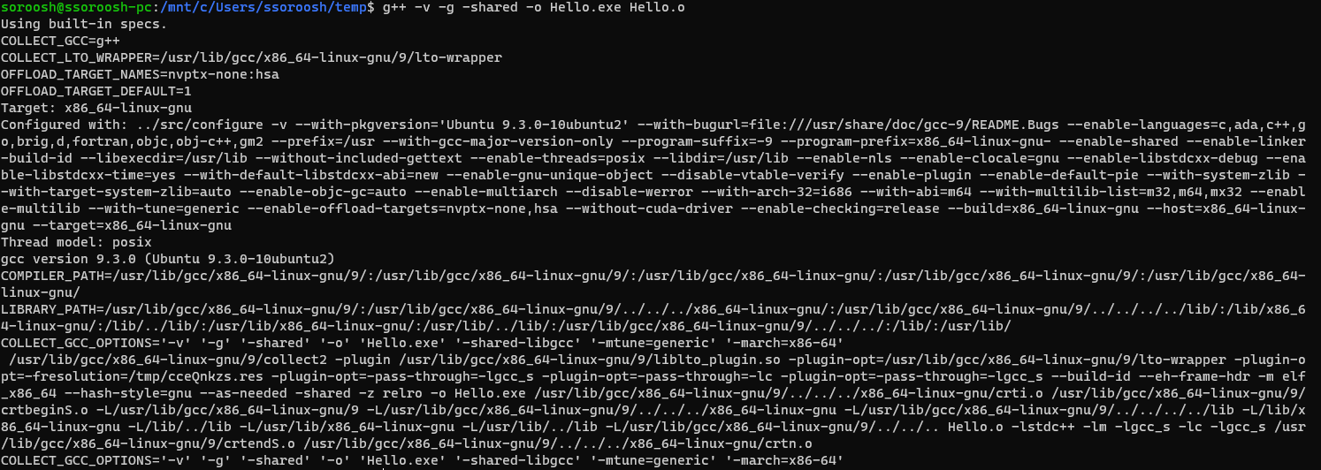
Verbose Mode -V
Notes:
Defining Macro (-D)

Slide 12
Library
A library is a collection of pre-compiled object files that can be linked into your programs via the linker.
When your program is linked against a static library, the machine code of external functions used in your program is copied into the executable.
When your program is linked against a shared library, only a small table is created in the executable. Before the executable starts running, the operating system loads the machine code needed for the external functions
Notes:
A static library has file extension of ".a" (archive file) in Unixes or ".lib" (library) in Windows.
. A static library can be created via the archive program "ar.exe".

Slide 13
Dynamic Linking
A shared library has file extension of ".so" (shared objects) in Unixes or ".dll" (dynamic link library) in Windows.
Dynamic linking makes executable files smaller and saves disk space
Often save memory
The shared library codes can be upgraded without the need to recompile your program.
Because of the advantage of dynamic linking, GCC, by default, links to the shared library if it is available.
Notes:
because one copy of a library can be shared between multiple programs
Furthermore, most operating systems allows one copy of a shared library in memory to be used by all running programs, thus, saving memory

Slide 14
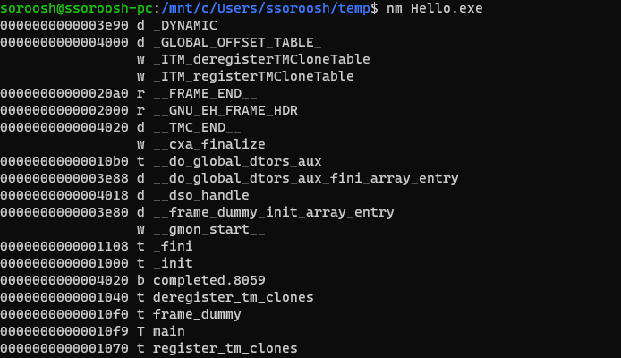
NM list symbols from objects file

Slide 15
Searching for Header Files and Libraries
The include-paths are specified via -Idir option –I
The library-path is specified via -Ldir option –L
you also have to specify the library name. –l
Notes:
Exclude standard library
(or environment variable CPATH).
(or environment variable LIBRARY_PATH)
In Unixes, the library libxxx.a is specified via -lxxx option (lowercase letter 'l', without the prefix "lib" and ".a" extension). In Windows, provide the full name such as -lxxx.lib. The linker needs to know both the directories as well as the library names. Hence, two options need to be specified.
https://tldp.org/HOWTO/Program-Library-HOWTO/shared-libraries.html
https://stackoverflow.com/a/5186130/1539100
Cpp –v
PATH: For searching the executables and run-time shared libraries (.dll, .so).
CPATH: For searching the include-paths for headers. It is searched after paths specified in -I<dir> options. C_INCLUDE_PATH and CPLUS_INCLUDE_PATH can be used to specify C and C++ headers if the particular language was indicated in pre-processing.
LIBRARY_PATH: For searching library-paths for link libraries. It is searched after paths specified in -L<dir> options.

Slide 16
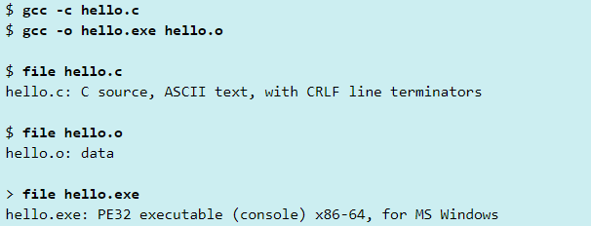
"file" Utility - Determine File Type

Slide 17
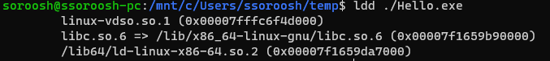
"ldd" Utility - List Dynamic-Link Libraries

Slide 18
GNU Make
Notes:
The "make" utility automates the mundane aspects of building executable from source code. "make" uses a so-called makefile, which contains rules on how to build the executables.
You can issue "make --help" to list the command-line options; or "man make" to display the man pages.

Slide 19
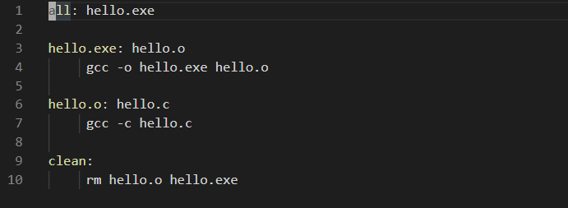
First Makefile By Example

Slide 20
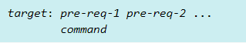
Structure
Running make without argument starts the target "all" in the makefile.
A makefile consists of a set of rules.
A rule consists of 3 parts: a target, a list of pre-requisites and a command
The command must be preceded by a tab (NOT spaces)
Notes:
The target and pre-requisites are separated by a colon (:). The command must be preceded by a tab (NOT spaces).

Slide 21
Golden Behavior
When make is asked to evaluate a rule, it begins by finding the files in the prerequisites. If any of the prerequisites has an associated rule, make attempts to update those first.
if the pre-requisite is not newer than than target, the command will not be run
Notes:
In the above example, the rule "all" has a pre-requisite "hello.exe". make cannot find the file "hello.exe", so it looks for a rule to create it. The rule "hello.exe" has a pre-requisite "hello.o". Again, it does not exist, so make looks for a rule to create it. The rule "hello.o" has a pre-requisite "hello.c". make checks that "hello.c" exists and it is newer than the target (which does not exist). It runs the command "gcc -c hello.c". The rule "hello.exe" then run its command "gcc -o hello.exe hello.o". Finally, the rule "all" does nothing.
The makefile can be named "makefile", "Makefile" or "GNUMakefile", without file extension.

Slide 22
کمی بیشتر
Phony Targets
Syntax of Rules
Comment & Continuation
A target that does not represent a file is called a phony target.
Phony target is always out-of-date and its command will be run.
The standard phony targets are: all, clean, install
The rules are usually organized in such as way the more general rules come first.
#
\
Notes:
.PHONY: clean

Slide 23
Variables
Automatic Variables
$ () or {}
Automatic variables are set by make after a rule is matched.
$(CC)
${CC}
Single character variables do not need the parentheses.
$*: the target filename without the file extension.
$<: the first prerequisite filename.
$@: the target filename.
$^: the filenames of all the prerequisites, separated by spaces, discard duplicates.
$+: similar to $^, but includes duplicates.
$?: the names of all prerequisites that are newer than the target, separated by spaces.

Slide 24
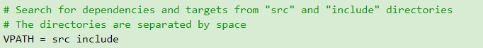
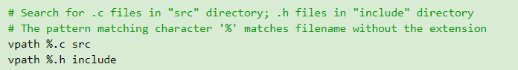
Virtual Path - VPATH & vpath
You can use VPATH (uppercase) to specify the directory to search for dependencies and target files.
You can also use vpath (lowercase) to be more precise about the file type and its search directory.

Slide 25
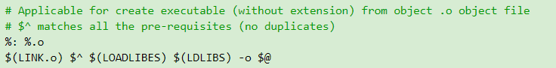
Pattern Rules
A pattern rule, which uses pattern matching character '%' as the filename
can be applied to create a target, if there is no explicit rule.
Notes:
can be applied to create a target, if there is no explicit rule. For example,
# Applicable for create .o object file. # '%' matches filename. # $< is the first pre-requisite # $(COMPILE.c) consists of compiler name and compiler options # $(OUTPUT_OPTIONS) could be -o $@ %.o: %.c $(COMPILE.c) $(OUTPUT_OPTION) $<
http://www.gnu.org/software/make/manual/make.html

Slide 26
